Slide 1

A transforming European sugar industry: new and better jobs in a competitive, innovative and sustainable industry
Kick off meeting – May 05, 2020

Slide 2
Content of the presentation
Content of the presentation
Objectives of the project
Overall approach
Methodology for specific project activities
Data collection strategy
Workshop facilitation
Final publication & final conference
Timetable for the project
Key points agreed

Slide 3

Objectives of the project

Slide 4
Objectives of the project
Map the relationship of social partners in the sugar industry across the EU from a qualitative perspective, collect good practices and assess the state of employment in the industry
Discuss the future of the sugar industry, including:
  efforts to further increase sustainability and to re-orient beet sugar production facilities to the production of other beet-derived products;
  the potential for future jobs in the sector and the skills required of the workers in a new, integrated approach to biorefinery.
Explore how to increase the sector’s attractiveness to young workers in a modernised labour market.
Explore how to facilitate intra-EU skills mobility.

Slide 5
Overall approach

Slide 6
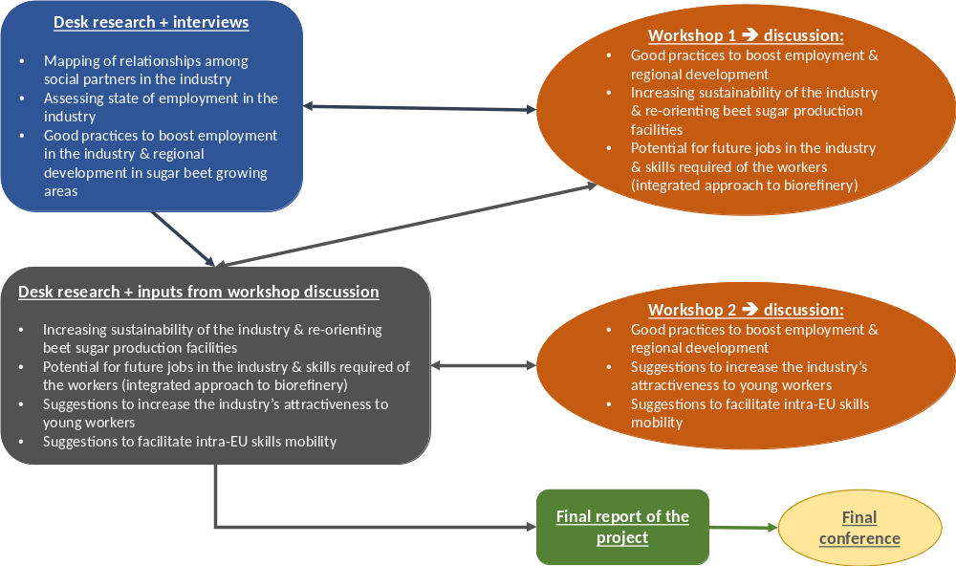
Overall approach

Slide 7
Methodology for specific project activities

Slide 8
Methodology for specific project activities
1: Mapping of the relationships among social partners in the European beet sugar sector
Identification of relevant social partners at EU and national level.
Key aspects of the relationship between social partners, social dialogue models in particular ➔ identification of good practices.
Desk research + interviews (close information gaps)

Slide 9
Methodology for specific project activities
2: Assessment of the state of employment in the European beet sugar sector
Key determinants of the socio-demographic situation of the workforce in the European sugar industry (previous research carried out on the topic ➔ CEFS/EFFAT “Socio-demographic analysis of the European Sugar Sector”, 2015).
Key determinants of job quality in the European sugar industry: eight compulsory minimum social standards and basic rights, joint CEFS/EFFAT “Code of Conduct” ➔ identification of good practices.
Desk research + interviews (close information gaps)

Slide 10
Methodology for specific project activities
3: Identification of good practices to boost employment in the European beet sugar sector and regional development in sugar beet growing areas
Will cover also good practices based on diversification towards value adding processes based on alternative uses for beet sugar and its by-products (molasses, pulps), for sugar beets and for residues of sugar beet cultivation (leaves).
Literature review + interview (CIBE or COPA-COGECA) + insights from 1st and 2nd workshops

Slide 11
Methodology for specific project activities
4: Insights into further increasing the sector’s sustainability and re-orienting beet sugar production facilities to the production of other beet-derived products
Will be elaborated starting from findings of activity 3 ➔ good practices to boost employment in the European beet sugar sector and regional development in sugar beet growing areas
Previous project on biobased economy for EFFAT
Literature review + insights from 1st workshop

Slide 12
Methodology for specific project activities
5: Insights into the potential for future jobs in the sector and the skills required of the workers in a new, integrated approach to biorefinery
Will be elaborated starting from:
findings of activity 3 ➔ good practices to boost employment in the European beet sugar sector and regional development in sugar beet growing areas;
findings of activity 4 ➔ insights into further increasing the sector’s sustainability and re-orienting beet sugar production facilities to the production of other beet-derived products
Previous project on biobased economy for EFFAT
Literature review + insights from 1st workshop

Slide 13
Methodology for specific project activities
6: Suggestions on how to increase the sector’s attractiveness to young workers in a modernised labour market
Critical review of the findings of specific activities of the project dealing with innovative strategies (e.g. implementation of value adding biobased processes; practical application of the biorefinery concept in the beet sugar industry)
Literature review + insights from 2nd workshop

Slide 14
Methodology for specific project activities
7: Suggestions on how to facilitate intra-EU skills mobility
Will be elaborated from:
Literature review + insights from 2nd workshop

Slide 15
Data collection strategy

Slide 16
Data collection strategy
Combination of:
Desk research (literature review + mining of relevant databases)
In-depth interviews
Insights from stakeholder consultation in the framework of 2 workshops
Focus data collection efforts – interviews in particular – on a selection of Member States and candidate countries of special interest for the project

Slide 17
Data collection strategy
Proposed selection of national focuses
Countries | Importance as beet sugar producer | Restructuring process / factory closures | Diversification of the sugar industry | Other national specificities
1. France | N° 1 in the EU | 5 factory closures (2006 reform); more planned/expected for 2020 | Significant ethanol production from sugar beets; diversification into bioproducts, organic sugar | Extensive control by beet growers on the sugar industry
2. Germany | N° 2 in the EU | 6 factory closures (2006 reform); more planned/expected for 2020 | Diversification into bioproducts, organic sugar | Extensive control by beet growers on the sugar industry
3. Poland | N° 3 in the EU | 13 factory closures (2006 reform); more planned/expected for 2020
4. United Kingdom | N° 4 in the EU | 2 factory closures (2006 reform) |  | Not an EU Member State since 2020 ➔ post-Brexit developments? Single beet sugar producing company Important refiner of cane sugar
5. Netherlands | N° 5 in the EU | 1 factory closure (2006 reform) ➔ only 2 factories in operation in 2019 campaign | PULP2VALUE project (beet pulps) ➔ diversification into bioproducts | Single beet sugar producing company Extensive control by beet growers on the sugar industry
6. Denmark |  | 1 factory closure (2006 reform) ➔ only 2 factories in operation in 2019 campaign |  | Single beet sugar producing company
7. Italy |  | 16 factory closures (2006 reform) + 1 closure in 2018 ➔ only 2 factories in operation in 2019 campaign | Diversification into organic sugar | Single beet sugar producing company Extensive control by beet growers on the sugar industry
8. Spain |  | 7 factory closures (2006 reform) | Diversification into bioproducts
9. Serbia | N° 2 among EU candidate countries | Recent drop in sugar beet production ➔ factory closures in 2020? |  | Candidate country to EU accession Leading sugar company owned by an EU-based group
10. Turkey | N° 1 among EU candidate countries | Privatisation of state-owned sugar producer ➔ factory closures (more expected in 2020?) |  | Candidate country to EU accession Important public presence in the sugar industry; further privatisation planned

Slide 18
Data collection strategy
Proposed interview plan
Geographical level | Target subjects | Planned number of interviews
7 sugar producing Member States (France, Germany, Poland, Netherlands, Denmark, Italy, Spain) | Organisation representing the interests of sugar producers / individual sugar producers (where no such organisation exists) Organisation representing the interests of workers in the sugar industry | 2 interviews per Member State ➔ 2 x 7 = 14
United Kingdom (former Member State) | Same as above | 2 interviews
2 candidate countries (Serbia, Turkey) | Same as above | 2 interviews per country ➔ 2 x 2 = 4
EU level | EU level organisation representing the interests of beet growers (CIBE or COPA-COGECA) European Commission – DG Employment Independent experts (academics, consultants) | 1 interview 1 interview 2 interviews ➔ 4
All levels |  | 20 + 4 ➔ 24

Slide 19
Workshop facilitation

Slide 20
Workshop facilitation
Proposed discussion topics - workshops
First workshop, to be held in Denmark in October/November 2020*
Identification of good practices to boost employment in the European beet sugar sector and regional development in sugar beet growing areas
Elaboration of insights into further increasing the sector’s sustainability and re-orienting beet sugar production facilities to the production of other beet-derived products
Elaboration of insights into the potential for future jobs in the sector and the skills required of the workers in a new, integrated approach to biorefinery
Second workshop, to be held in Spain in February/March 2021
Additional inputs for the identification of good practices to boost employment in the European beet sugar sector and regional development in sugar beet growing areas
Elaboration of suggestions on how to increase the sector’s attractiveness to young workers in a modernised labour market
Elaboration of suggestions on how to facilitate intra-EU skills mobility
* Possible challenges due to potential restrictions for Covid-19 emergency: solutions to be agreed with the SG

Slide 21
Workshop facilitation
Workshop facilitation
Materials (factsheets, presentations) with preliminary findings of the project to be discussed ➔ made available to participants at least one week before the workshops
Each workshop opens with 2-3 key note speakers on the topics of interest
Preliminary project results presented by the experts of the project team
Split workshop attendance into a convenient number of discussion groups ➔ World Café procedure to facilitate discussion in each group

Slide 22
Workshop facilitation
World Café procedure
Rounds of discussion | Activities
First round | Very broad questions to open the debate and to identify key topics to be addressed further ➔ first “voting” on hottest topics/challenges/opportunities
Second round | The identified key topics/challenges/opportunities are discussed more in depth ➔ more detailed questions. If needed, relation maps linking causes and effects, or lists of key findings can be elaborated on “wall posters”.
Third round | Key findings of the discussion ➔ inputs and insights into the topics of interest for the project

Slide 23
Final publication & final conference

Slide 24
Final publication & final conference
Final report
Final report to be written in clear and concise English ➔ well-structured document fit for publication, drafted in a style suitable for wider dissemination, and revised by a native English speaker.
Final conference
To be held in Belgium in September/October 2021.
Presentation of the final report of the project (key findings) by the study team.

Slide 25
Timetable for the project

Slide 26
Timetable for the project
Tasks | 2020 |  |  |  |  |  |  |  |  | 2021
 | 4 | 5 | 6 | 7 | 8 | 9 | 10 | 11 | 12 | 1 | 2 | 3 | 4 | 5 | 6 | 7 | 8 | 9 | 10
1.1 - Appointment by the contractor of a main point of contact for the project
1.2 - Establishing a concrete and detailed work plan to implement the contractual tasks
1.3 – Drafting of the deliverable “methodology and plan”
1.4 - Attend steering group meeting 1
2.1 - Conduct desk research to prepare the regional workshops in the form of tools, factsheets
2.2 – Drafting of the deliverable “tools and factsheets” for the first workshop
2.3 - Prepare for the first regional workshop
2.4 - Attend steering group meeting 2
2.5 - Attend the first regional workshop and help to facilitate debate and input during the workshop
2.6 - Help to evaluate the workshop’s outcomes
2.7 – Drafting of the deliverable “good practices” (as identified in the workshop)
3.1 - Drafting of the deliverable “tools and factsheets” for the second workshop
3.2 - Prepare for the second regional workshop
3.3 - Attend steering group meeting 3
3.4 - Attend the second regional workshop and help to facilitate debate and input during the workshop
3.5 - Help to evaluate the workshop’s outcomes
3.6 - Drafting of the deliverable “good practices” (as identified in the workshop)
4.1 - Finalise the report
4.2 – Drafting of a draft final report
4.3 – Attend steering group meeting 4
4.4 – Review of the draft final report è final version of the report
4.5 - Attend steering group meeting 5
4.6 - Attendance and presentation of the report at the final conference
4.7 - Help to evaluate the final event and suggest next steps

Slide 27
Key points agreed

Slide 28
Key points agreed
Shift to end of May of the deadline for the following activities
  1.2 - Establishing a concrete and detailed work plan to implement the contractual tasks
  1.3 – Drafting of the deliverable “methodology and plan”
National focuses for in-depth analysis: substitute Serbia and Turkey with Austria and Belgium (this also includes the related interviews)
Focus on elaborating concrete suggestions, albeit keeping an open mind towards possible paths to innovation and a forward-looking perspective

Slide 29
Thank you for your attention!
Contacts
Areté s.r.l.
www.areteonline.net
Via del Gomito 26/4, I - 40127 Bologna
Tel +39 051 4388500 - Fax +39 051 561186
    Project Manager for the study:
    Enrica Gentile
    egentile@areteonline.net

